Slide 1

Software Life Cycle
Requirements analysis
System design
Program design
Program implementation (coding)
Unit testing
Integration testing
System testing
Deployment
Maintenance
Retirement
Migration

Slide 2
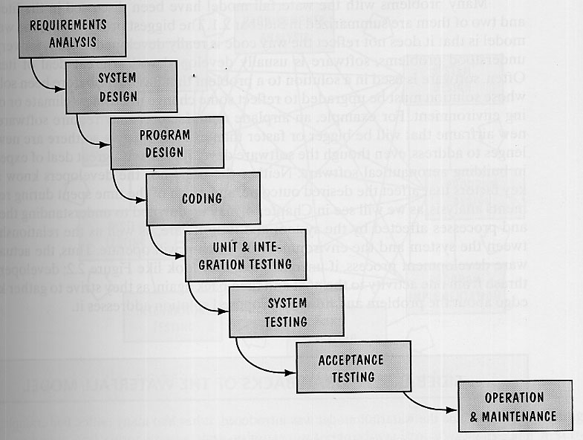
Waterfall Model

Slide 3
Waterfall Model
+Simple
+Efficient
+Easy to Manage
-Does not fit real-life (requirements are never correct or exact and planning is never perfect)
-Does not provide means for dealing with unplanned changes

Slide 4
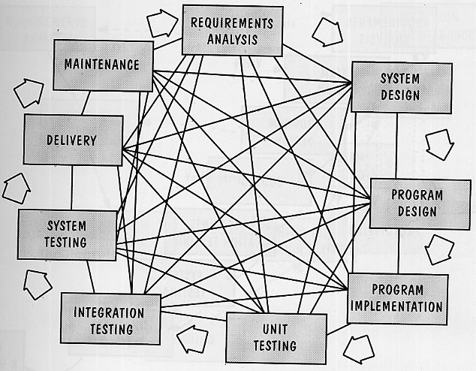
Reality…

Slide 5
Prototyping
Key Problem: Unclear Specification, Poor Understanding of the process.
Solution: Prototyping!
User’s get to feel the system and designers get to know what users want or need. Specification kinks are worked out.

Slide 6
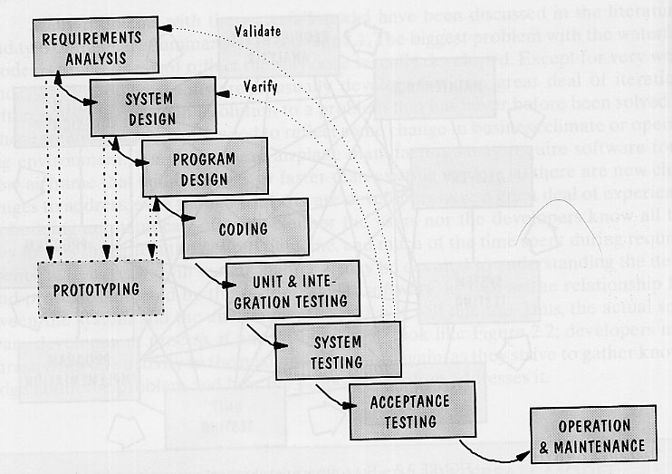
Waterfall Model with Prototyping

Slide 7
Validation
A process that ensures that:
the system has implemented ALL the requirements in the specification;
All the implemented features correspond to the requirements.
I.e. validation checks FEATURES.

Slide 8
Verification
Ensures that each function works correctly.
I.e. verification checks QUALITY.

Slide 9
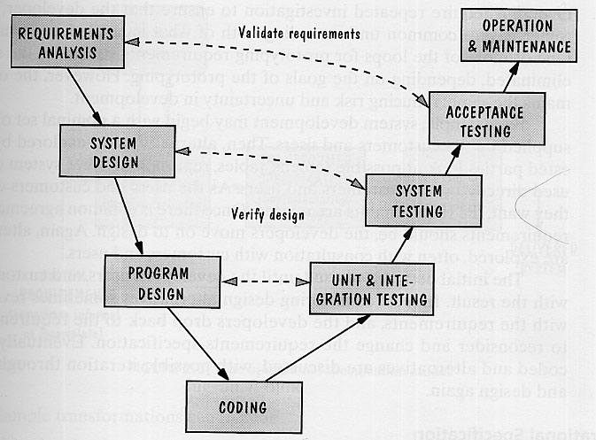
V Model

Slide 10
V Model
Demonstrates how testing activities relate to analysis and design.
+Allows refining of previous development steps.
+Allows fallback / correction.

Slide 11
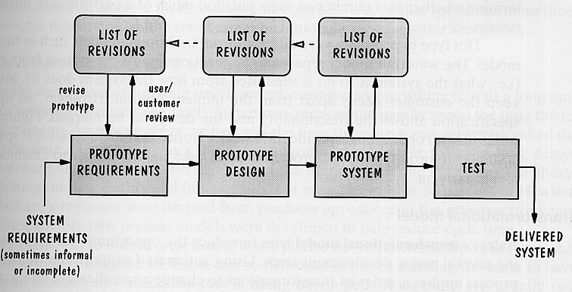
Prototyping Model
Excellent for poorly understood systems or processes.

Slide 12
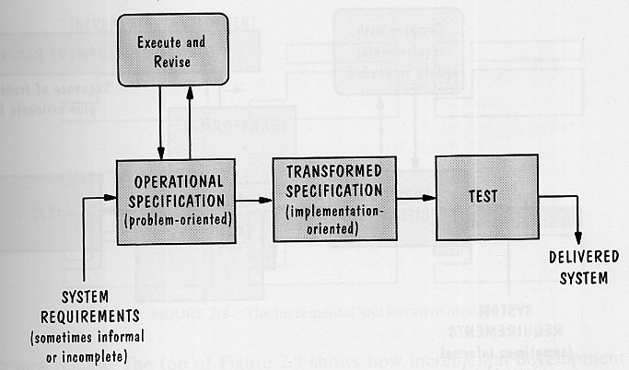
Operational Specification
* Meant for projects with poorly understood requirements.
* Requirements are evaluated (enacted) in order to extract implications for the system design.

Slide 13
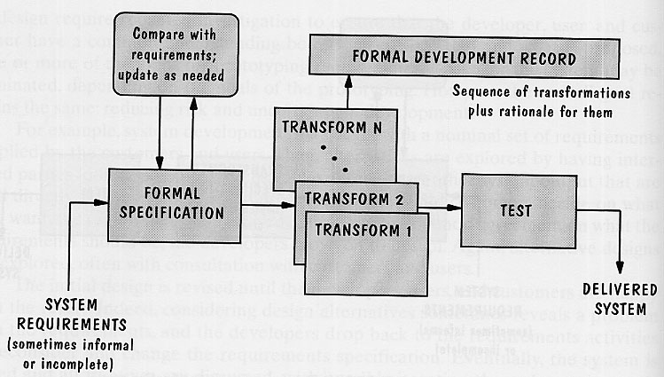
Transformation Model
Currently utopian ultimate goal to eliminate coding by allowing specification to be transformed into final product. But how?

Slide 14
Phased Development
Software development process amounts to a sequence of build & release events.
+ Quick turn-around
+ Fast time to market
Bugs / wrong features released
Still requires process model for each build & release iteration.
Most projects are incremental!
* Requires development, testing, QA, and production systems.

Slide 15
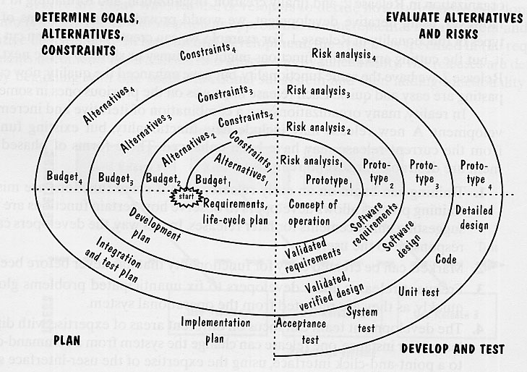
Spiral Model

Slide 16
Spiral Model
Built around risk-management in order to minimize and control risk.
An iterative model:
  With each iteration risk analysis weighs alternatives in light of requirements and constraints
  Prototype is built to verify feasibility of the chosen approach
  Feasible prototypes are implemented
The most rigorous process available

Slide 17
Agile Methodology
Developed as a counter-rigor approach.
Individuals are valued over processes and tools (which means developers get all the goodies they need/want).
Informal communication is more important than written documentation.
Working code is more important than formal documentation / specification.
Collaboration with customer important.
Response to change is immediate and requires no formal planning.
+ Good for homogeneous enthusiast-type groups with low cadre turn-over.
- Poor for controlled environments.

Slide 18
Agile Methods
Extreme Programming (XP) involves back-to-back edits of the code by paired developers. Maximum creativity, minimum administration.
Crystal approach is based on the notion that the ‘higher quality’ people producer higher quality software. Frequent delivery is important.
Scrum relies on 30-day “sprint” iterations. Multiple self-contained team incrementally improve the product in parallel.
Adaptive Software Development is organized around delivering product features. Re-doing is as important as doing. Change are expected. Hardest problems are tackled first. Features dumped to meet deadlines.

Slide 19
Key Benefits of Agile / XP
+ Leverages creativity.
+ Encourages communication & feedback on all stages of development and among all team members (including customers).
+ Minimizes administrative overhead.
+ Encourages simplicity, fast releases.

Slide 20
Twelve Facets of XP
1.Planning: each user describes how the system should work and what value each feature provides (user accounts are reconciled by developers in order to determine what features are needed and testable).
2. Small releases: the goal is to deliver fast and provide increments on ongoing basis.
3. Metaphor: common lexicon and vision is adopted.
4. Simplicity is the key.
5. Tests are written first (functional specified by customer; unit tests written by developers).
6. Refactoring of specs, code, design, etc.
7. Pair programming
8. Collective ownership (anybody can change anything)
9. Continuous availability (the system can be built anytime)
10. Sustainable development pace (no heroism!)
11. Customer availability (preferably on site!)
12. Coding standards are enforced.

Slide 21
Disadvantages of XP
Test cases do not necessarily correspond to requirements.
It may be more important to take time and find out what really needs to be done rather than quickly do something that is not really needed.
Refactoring degrades system architecture.
Cannot be practiced in loose or geographically spread-out environment.

Slide 22
Process Modeling
UML
Class Diagrams
Block Diagrams
State Diagrams
Turn Key
Idle
Press Clutch
Turn Key
Depress Clutch
Off
No Gas
Go
Turn Key

Slide 23
Exercise
Create block-diagram of N-body O(N²) code.
Create state-diagram of the calculation process.

